Slide 1
Informatica PowerCenter
Lesson 21: Error Handling Techniques

Slide 2
Lesson Objectives
In this Lesson you will learn about:
  Introduction to Row Error Logging
  Steps For Implementation

Slide 3
20.1. Introduction To Error Handling Techniques
Data Quality is very critical to the success of every data warehouse projects. So ETL Architects and Data Architects spent a lot of time defining the error handling approach. Lets see how do we leverage the PowerCenter options to handle your exceptions.
Error Classification
  Fatal Errors – Which breaks the flow /stops the workflow
  Non-Fatal Error –
    Unexpected Conversion Error or other error due to which record is skipped
    User defined /Logic failure Exception
User Defined Exception
  Business users define the user defined user defined exception, which is critical to the data quality. We can setup the user defined error handling using;
  Error Handling Functions.
  User Defined Error Tables.

Slide 4
20.1. Error Handling Functions
ERROR() :
  This function Causes the PowerCenter Integration Service to skip a row and issue an error message, which you define.
  The error message displays in the session log or written to the error log tables based on the error logging type configuration in the session.
  You can use ERROR in Expression transformations to validate data
Eg IIF(TRANS_DATA > SYSDATE,ERROR('Invalid Transaction Date'))
ABORT() :
  Stops the session, and issues a specified error message to the session log file or written to the error log tables based on the error logging type configuration in the session.
  When the PowerCenter Integration Service encounters an ABORT function, it stops transforming data at that row.
  It processes any rows read before the session aborts
  E.g. : IIF(ISNULL(LTRIM(RTRIM(CREDIT_CARD_NB))),ABORT('Empty Credit Card Number'))

Slide 5
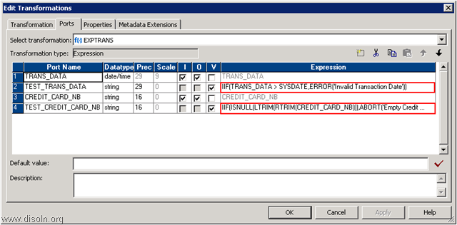
21.2. Error Handling Function
Example Of Using Error Handling Functions
Note :- You need to use these two functions in a mapping along with a session configuration for row error logging to capture the error data from the source system. Depending on the session configuration, source data will be collected into Informatica predefined PMERR error tables or files.
Notes:
Use this mapping when you do not you need to keep any previous versions / history of dimensions in the table.

Slide 6
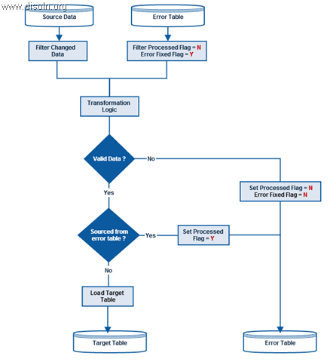
20.2. User Defined Error Handling
High Level Approach of Error Handling

Slide 7
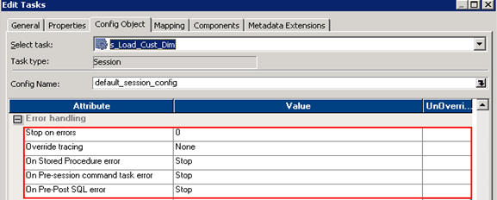
20.2. User Defined Error Handling
Non-Fatal Exception Can be handled by
  Default Port Value Setting.
  Row Error Logging.
  Error Handling Settings.
Default Port Value Setting : Good way to handle Null , invalid dates , etc.
  Row Error Logging – Configuring the session property
  Error Handling Settings : Configuring session -> Configure Objects -> Error Handling following options are available
  Stop – will stop the session on failure of the task.

Slide 8
20.3. Handling Fatal Errors
For Handling Fatal Error either we need to design
  Workflow Recovery
  Restartable ETL Design

Slide 9
Workflow Recovery Overview
Workflow recovery allows you to continue processing the workflow and workflow tasks from the point of interruption.
  You can recover a workflow if the Integration Service can access the workflow state of operation.
  The workflow state of operation includes the status of tasks in the workflow and workflow variable values.
  The Integration Service stores the state in memory or on disk, based on how you configure the workflow:
    Enable recovery
    Suspend
The Integration Service recovers tasks in the workflow based on the recovery strategy of the task.
By default, the recovery strategy for Session and Command tasks is to fail the task and continue running the workflow. You can configure the recovery strategy for Session and Command tasks.
The strategy for all other tasks is to restart the task.

Slide 10
Suspending the Workflow
When a task in the workflow fails, you might want to suspend the workflow, fix the error, and recover the workflow.
The Integration Service suspends the workflow when you enable the Suspend on Error option in the workflow properties.
Optionally, you can set a suspension email so the Integration Service sends an email when it suspends a workflow.
When you enable the workflow to suspend on error, the Integration Service suspends the workflow when one of the following tasks fail:
  Session
  Command
  Worklet
  Email
When the status of the workflow is “Suspended” or “Suspending,” you can fix the error, such as a target database error, and recover the workflow in the Workflow Monitor.
When you recover a workflow, the Integration Service restarts the failed tasks and continues evaluating the rest of the tasks in the workflow. The Integration Service does not run any task that already completed successfully.

Slide 11
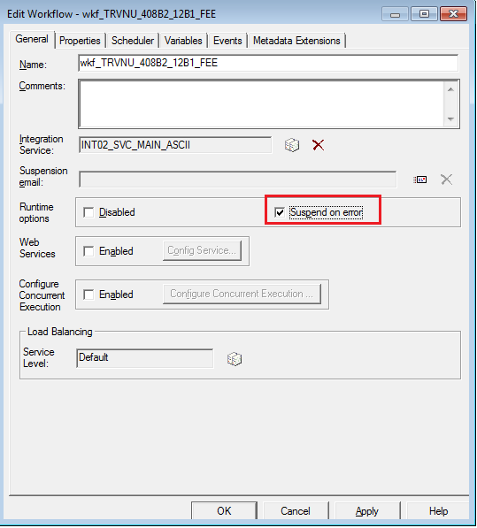
Suspending the Workflow
To suspend a workflow:
1.In the Workflow Designer, open the workflow.
2.Click Workflows > Edit.
3. In the General tab, enable Suspend on Error.
4.Click OK.

Slide 12
Workflow Recovery
To recover the workflow, you must enable the workflow for recovery or configure the workflow to suspend on task error. When the workflow is configured for recovery, you can recover it if it stops, aborts, terminates, or suspends.
There are 4 Recoverable workflow status
[1] Aborted :
You abort the workflow in the Workflow Monitor or through pmcmd.
You can also choose to abort all running workflows when you disable the service process in the Administration Console.
You can recover an aborted workflow if you enable the workflow for recovery.
You can recover an aborted workflow in the Workflow Monitor or by using pmcmd.
[2] Stopped:
You stop the workflow in the Workflow Monitor or through pmcmd.
You can also choose to stop all running workflows when you disable the service or service process in the Administration Console.
You can recover a stopped workflow if you enable the workflow for recovery.
You can recover a stopped workflow in the Workflow Monitor or by using pmcmd.

Slide 13
Workflow Recovery
[3] Suspended:
A task fails and the workflow is configured to suspend on a task error.
If multiple tasks are running, the Integration Service suspends the workflow when all running tasks either succeed or fail.
You can fix the errors that caused the task or tasks to fail before you run recovery.
By default, a workflow continues after a task fails. To suspend the workflow when a task fails, configure the workflow to suspend on task error.
[4] Terminated:
The service process running the workflow shuts down unexpectedly. Tasks terminate on all nodes running the workflow.
A workflow can terminate when a task in the workflow terminates and you do not have the high availability option.
You can recover a terminated workflow if you enable the workflow for recovery.
When you have high availability, the service process fails over to another node and workflow recovery starts.

Slide 14
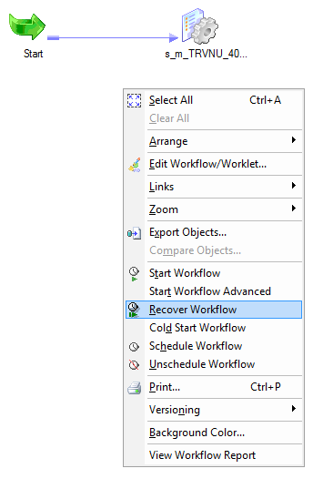
Recovering a Workflow
To recover a workflow using the Workflow Manager:
1. Select the workflow in the Navigator or open the workflow in the Workflow Designer workspace.
2. Right-click the workflow and choose Recover Workflow.
The Integration Service recovers the interrupted tasks and runs the rest of the workflow.

Slide 15
Task Recovery
When you recover a workflow, the Integration Service recovers the tasks based on the recovery strategy for each task.
Depending on the task, the recovery strategy can be fail task and continue workflow, resume from the last checkpoint, or restart task.
When you enable workflow recovery, you can recover a task that you abort or stop.
You can recover a task that terminates due to network or service process failures.
When you configure a workflow to suspend on error, you can recover a failed task when you recover the workflow.
There are 3 Task Recovery Strategies
[1] Restart task:
When the Integration Service recovers a workflow, it restarts each recoverable task that is configured with a restart strategy.
You can configure Session and Command tasks with a restart recovery strategy. All other tasks have a restart recovery strategy by default.

Slide 16
Task Recovery
[2] Fail task and continue workflow:
When the Integration Service recovers a workflow, it does not recover the task.
The task status becomes failed, and the Integration Service continues running the workflow.
Configure a fail recovery strategy if you want to complete the workflow, but you do not want to recover the task.
You can configure Session and Command tasks with the fail task and continue workflow recovery strategy.
[3] Resume from the last checkpoint:
The Integration Service recovers a stopped, aborted, or terminated session from the last checkpoint.
You can configure a Session task with a resume strategy.
Notes: You can use one of the following methods to recover a workflow or task:

Slide 17
Recover a workflow. Continue processing the workflow from the point of interruption.
Recover a session. Recover a session but not the rest of the workflow.
Recover a workflow from a session. Recover a session and continue processing a workflow.

Slide 18
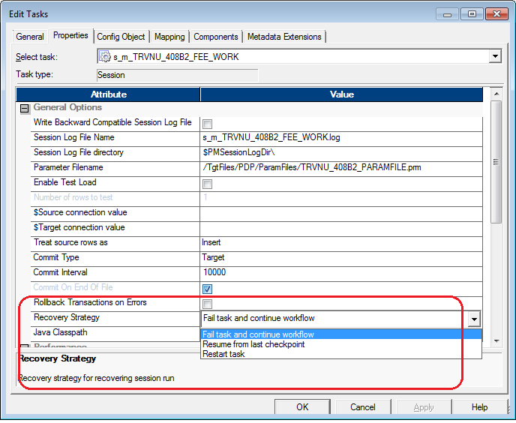
Task Recovery Strategies

Slide 19
Review Question
Which is NOT Recoverable workflow status ?
  Aborted
  Stopped
  Suspended
  Terminated
  Declined
Which is NOT Task Recovery Strategies ?
  Recover a workflow
  Restart task
  Fail task and continue workflow
  Resume from the last checkpoint
Option E
Option A

Slide 20
Summary
This Lesson gives knowledge Row Error Logging , its implementation and advantages

Slide 21
Review Question
We have to create Error tables for Row Error logging ?
  no
  yes
Error logging is done for
  Performance Gain
  Data Quality
Option A
Option B

